Slide 1

#WhatsYourOrder #DeliverYou

Slide 2


‘Deliver You’ is the name of the national campaign across England, which asks for views directly from young people to inform the National Youth Strategy.
The campaign, co-produced with young people, is an ambitious and exciting opportunity for young people to share their views, experiences, and ideas- and to tell the Government what really matters to them.
#WhatsYourOrder #DeliverYou
#WhatsYourOrder #DeliverYou

Slide 3

What is the National Youth Strategy?
The Government is creating a new ten year National Youth Strategy to tackle the challenges for this generation of young people and ensure that every young person can thrive.
The National Youth Strategy will bring power back to young people and their communities and improve youth focused services, moving away from a one-size-fits-all approach from Government.
Why is your voice important?
Young people are not just the leaders of tomorrow—you are are the changemakers of today. Your voices, ideas, and actions are vital in shaping inclusive, forward-thinking communities and Government.
The government is committed to giving young people a powerful voice in this process, and want the Strategy to be truly co-produced.
We plan to publish the National Youth Strategy in the summer, with an interim report called ‘Today’s Youth, Tomorrow’s Nation’ to come out in the spring.
Timelines?
Place your Order by completing the online survey from 5th March until 16th April 2025
Take orders through running a session between 5th March and May 16th 2025
Shape the solutions through the in-person events from 1st April to May 8th 2025

Slide 4


What are your biggest worries right now?
#WhatsYourOrder #DeliverYou

Slide 5

What are your hopes
for the future?
#WhatsYourOrder #DeliverYou

Slide 6

What one thing should the government do to improve things for young people?
#WhatsYourOrder #DeliverYou

Slide 7

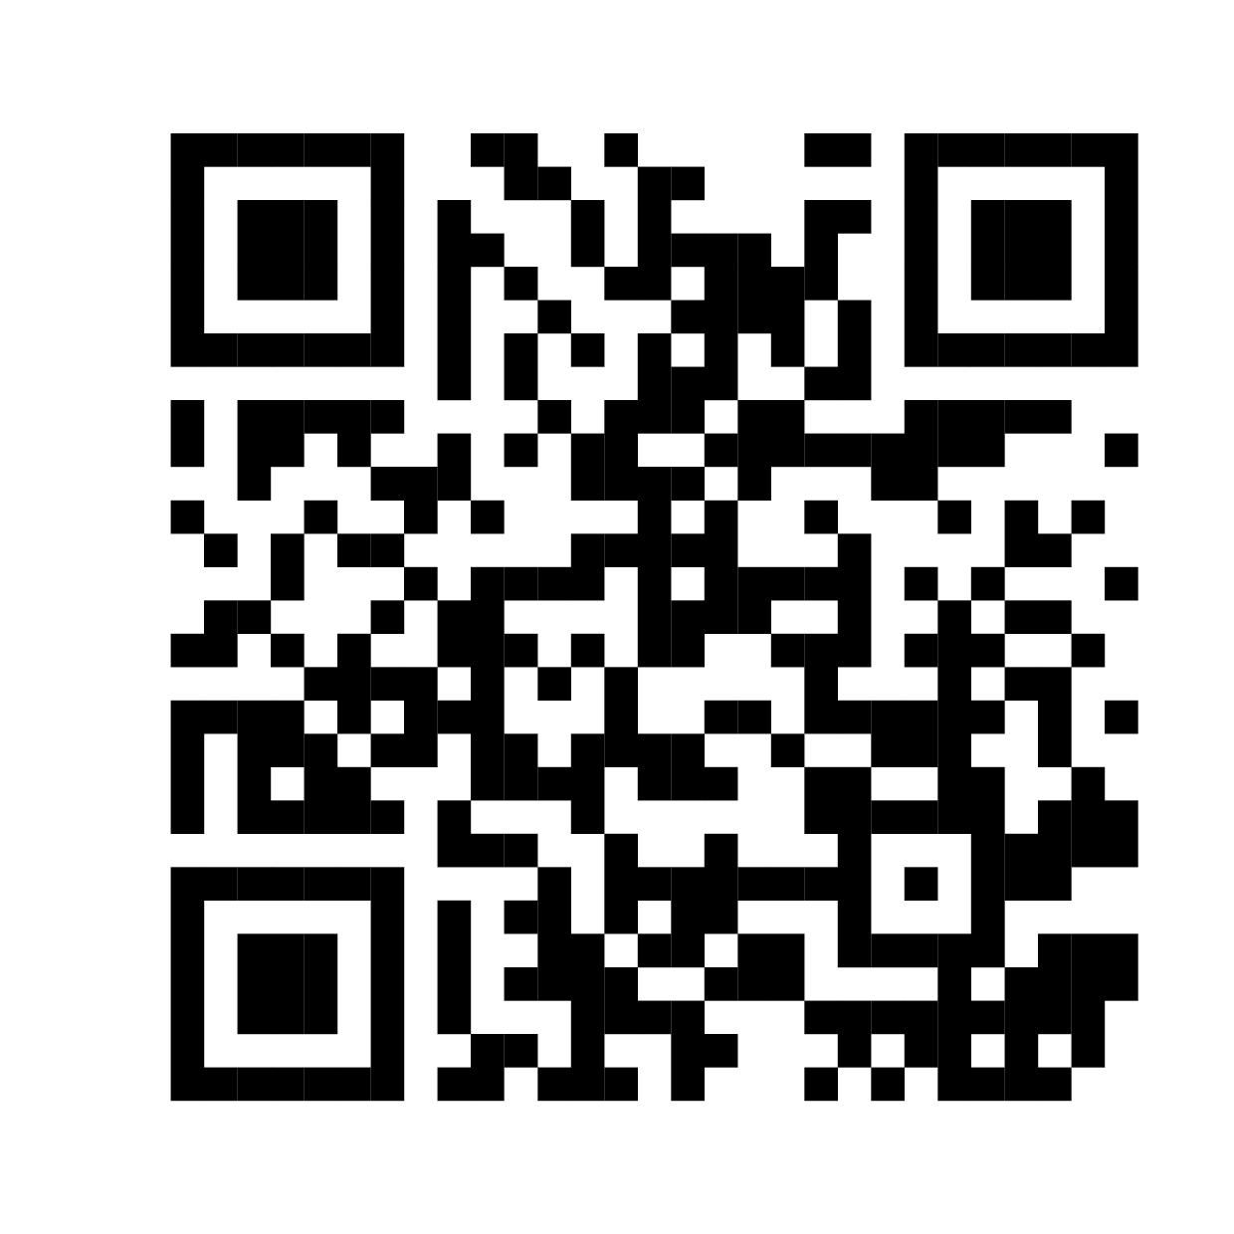
How to get involved!
Place your order! Complete the survey by 16th April!
Share your order via a post or reel on social media
Share the campaign with your friends
Run a discussion like this with your friends
Come to one of the 6 solution focussed hacks across the country
The National Youth Strategy is HAPPENING! Place your order and help shape your future!
#WhatsYourOrder #DeliverYou

Slide 8


